Slide 1
IST 659 Ball Games Database
Aruneema
Kaushik Rohida
Victor Igwe
Wei Liao

Slide 2
Agenda
Objective
Goals
ERD Diagram
Conceptual Model
Logical Model
Demonstration
UI Layout
Planning Stage
Analysis Stage
Design Stage
Implementation Stage

Slide 3
Objective
To create a portal that acts as single source of record for repeatable, measurable events
- Sports Games
So that people get information about
types, locations, time and price of the tickets for each game happening nearby,
as well as the availability of accommodations, transportation and restaurants.

Slide 4
Goals
Optimize user Journey

Slide 5
Goals
1. offer accurate and up-to-date information about different ball games in New York State
2. provide access to check prices and availability of tickets and hotels
3. Save people’s time on searching for information about tickets and accommodations, transportation and restaurants
4. Future implications- printing tickets, make recommendations for users

Slide 6
Assumptions
There are 6 stadiums in New York
The games and games details mentioned in the databases are representative of all the games in NY state
Some of the tickets are sold out
The names of hotels and restaurants are representative of all the brands present in the area
One game is played in one stadium in one day
Only two teams play in one game

Slide 7
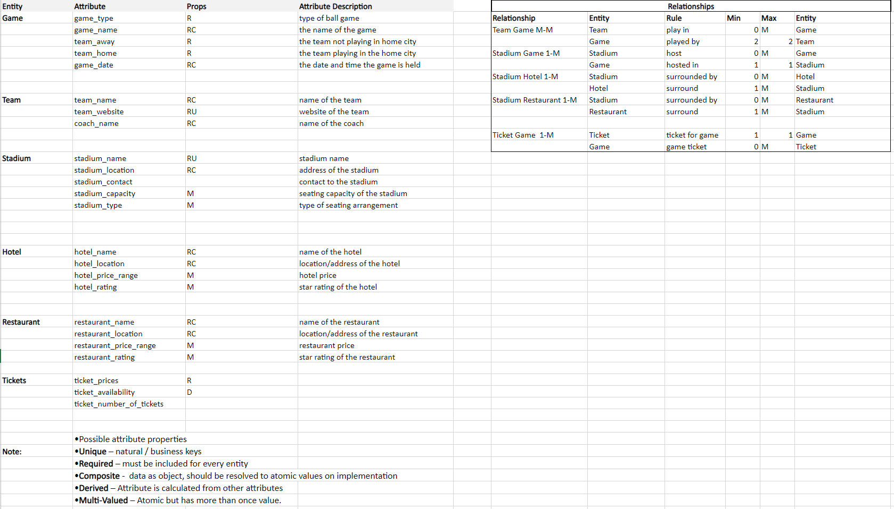
ERD Diagram

Slide 8
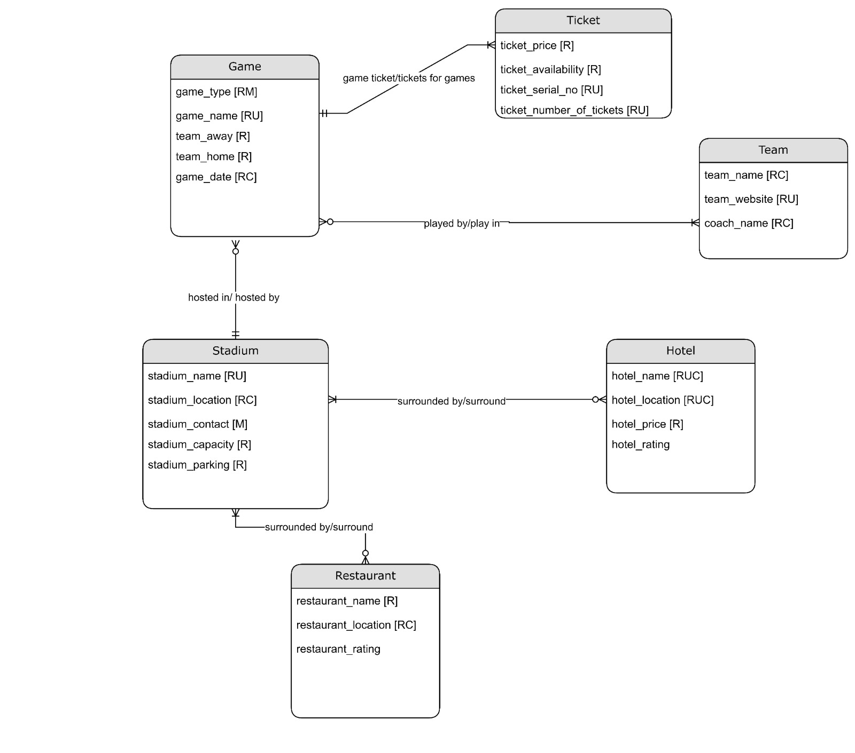
Conceptual model
Notes:
Table
-name
-description
-keys
-attributes

Slide 9
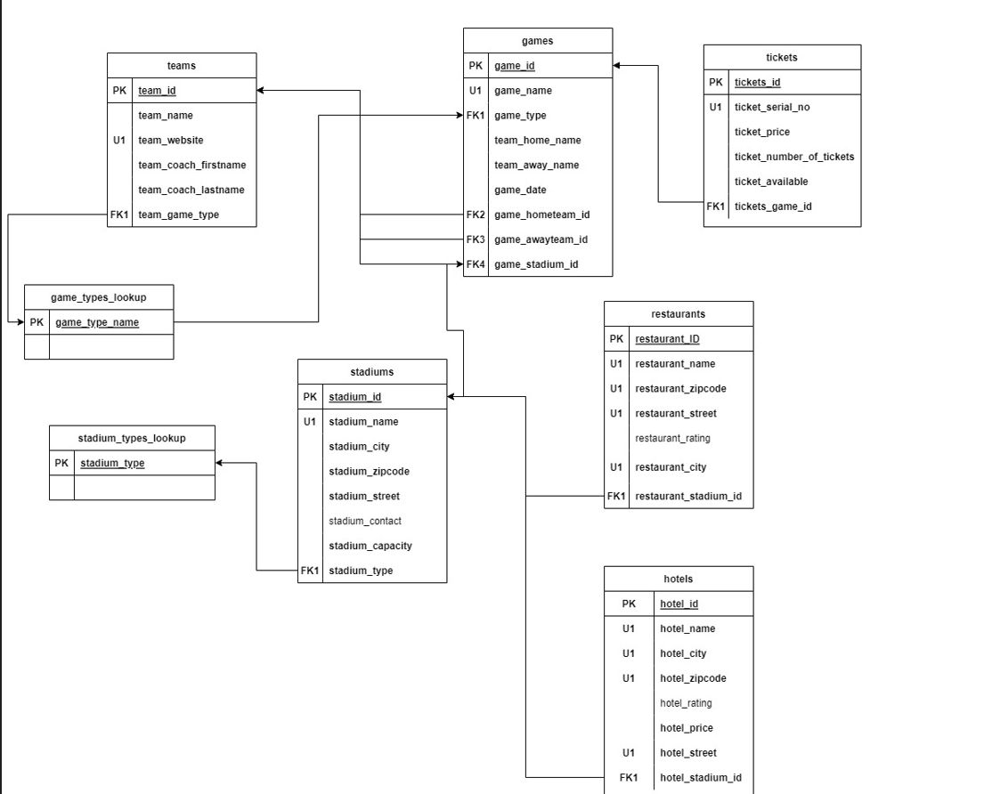
Logical model

Slide 10
Demonstration
Views, Procedure, Triggers

Slide 11
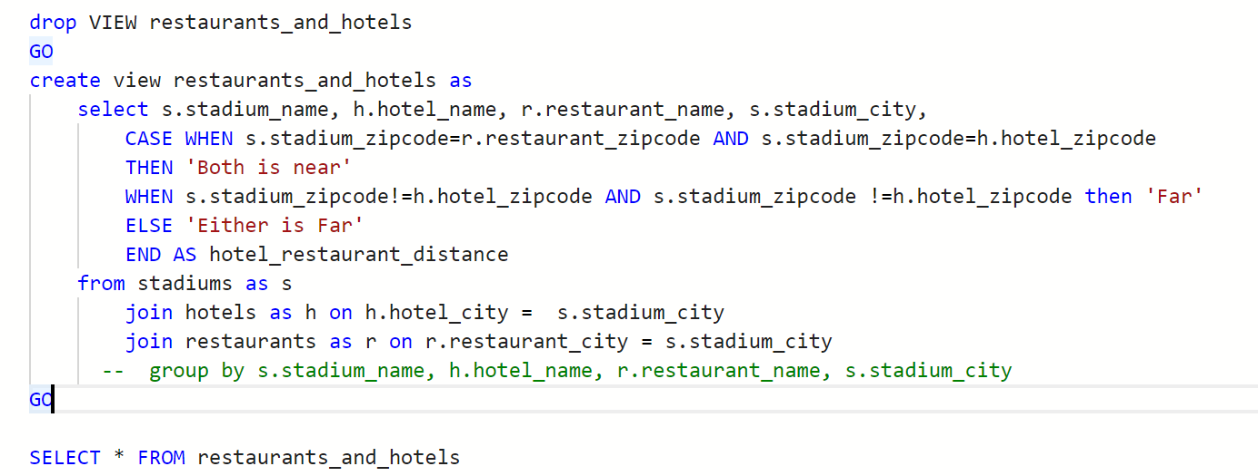
Views
What are the hotels and restaurants available near the stadium?

Slide 12
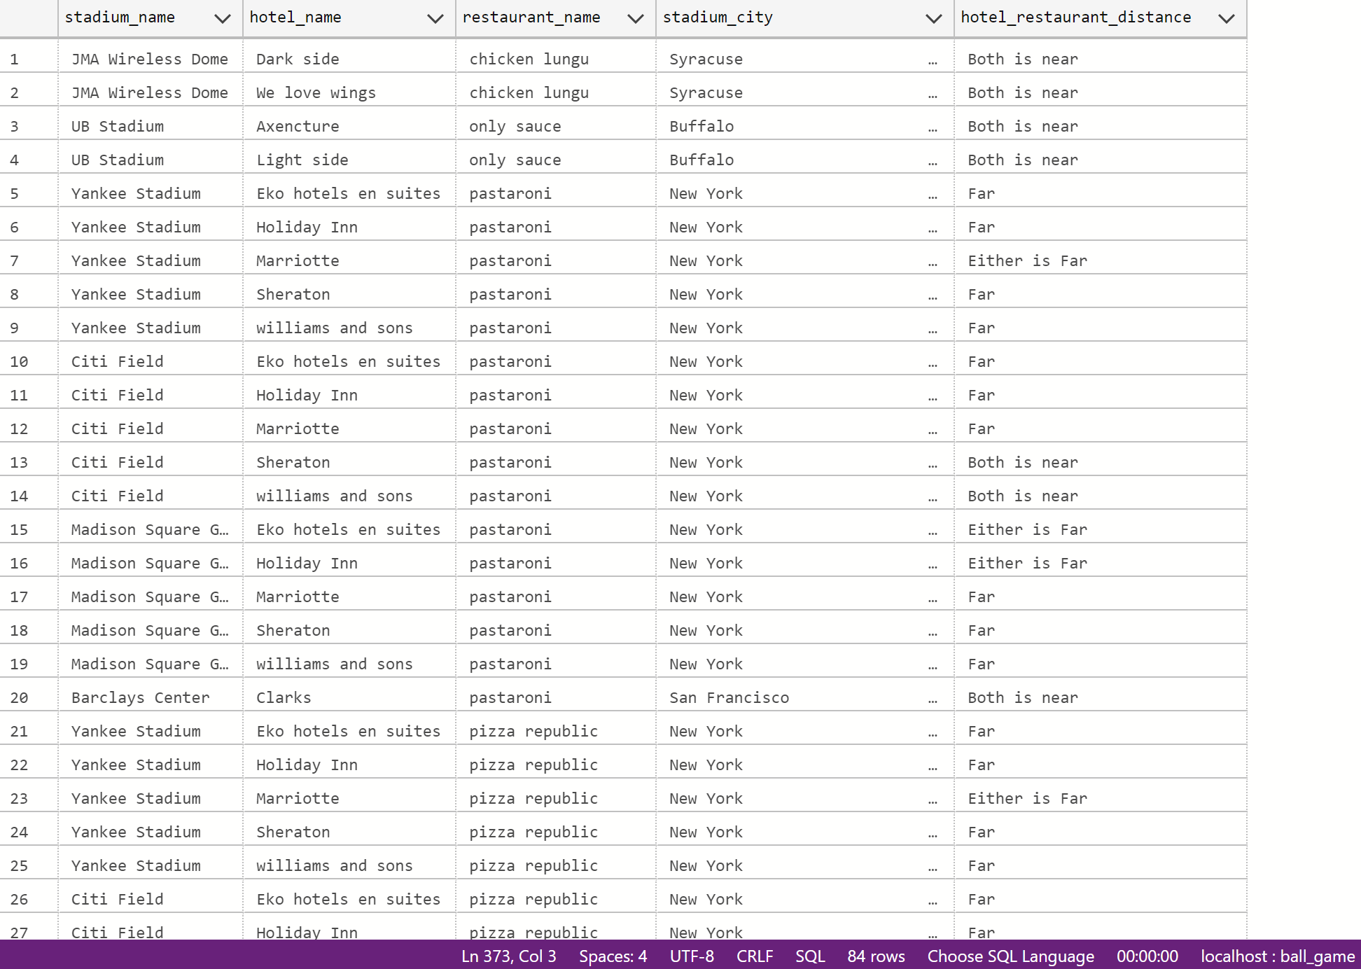

Slide 13
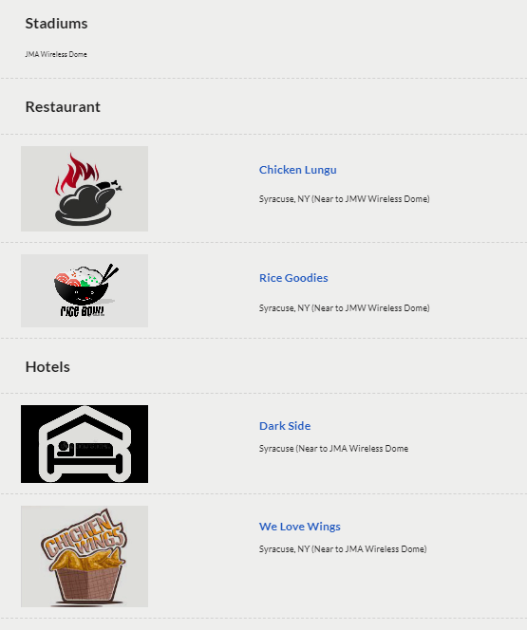

Slide 14
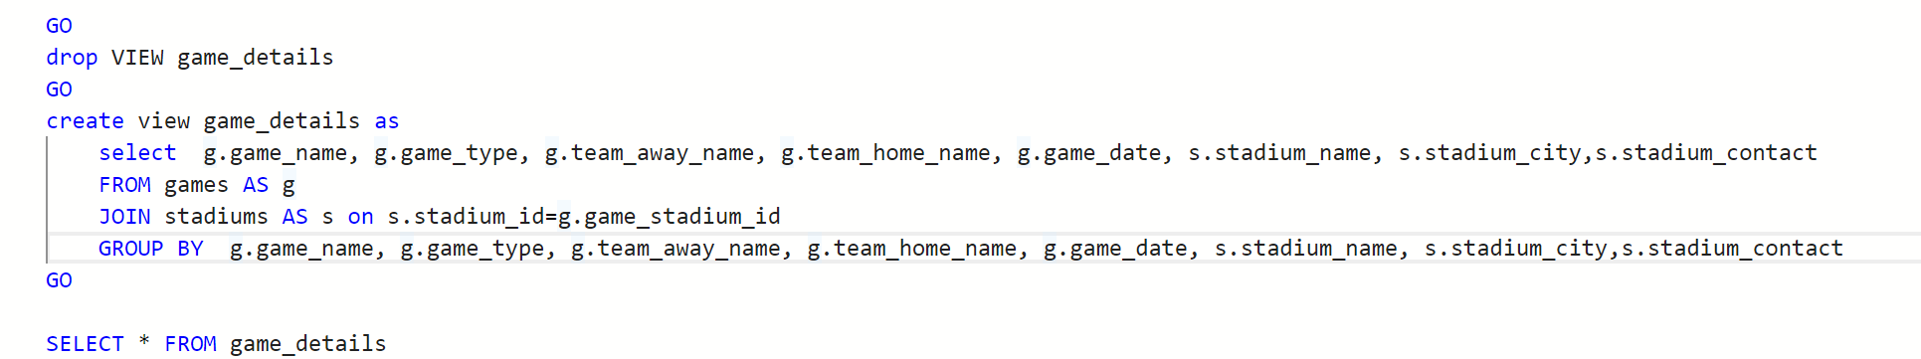
What game is held, between whom, where (city,stadium) and contact of place

Slide 15
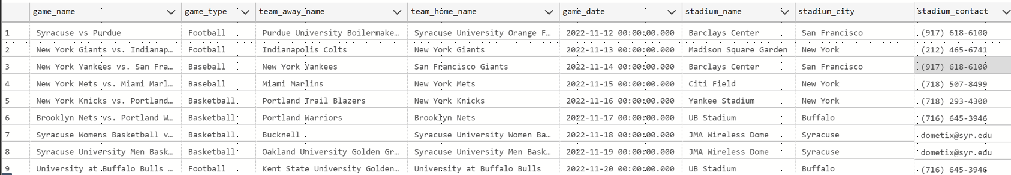

Slide 16
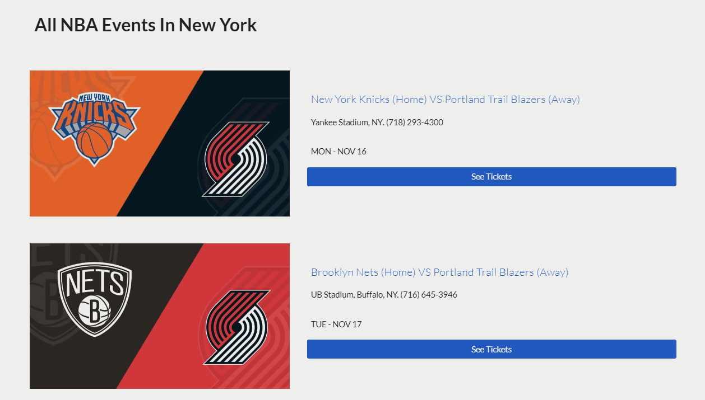

Slide 17
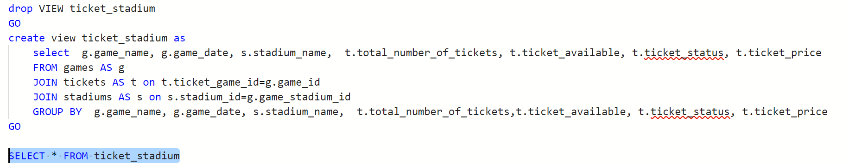
What is the ticket price and availability of the different games?

Slide 18
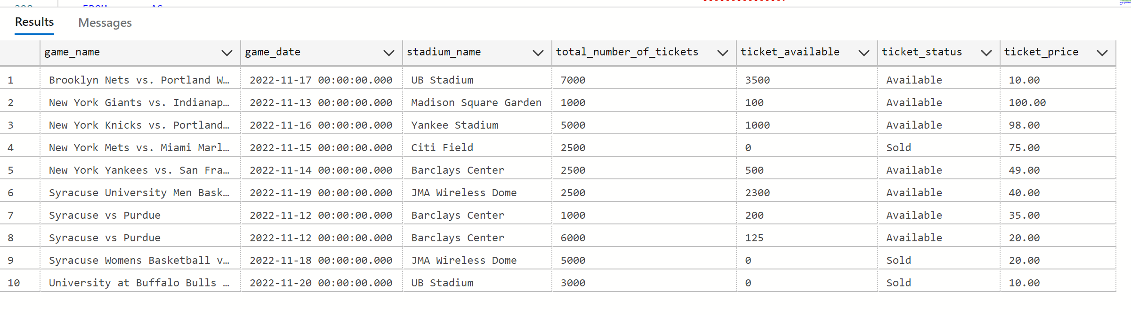

Slide 19
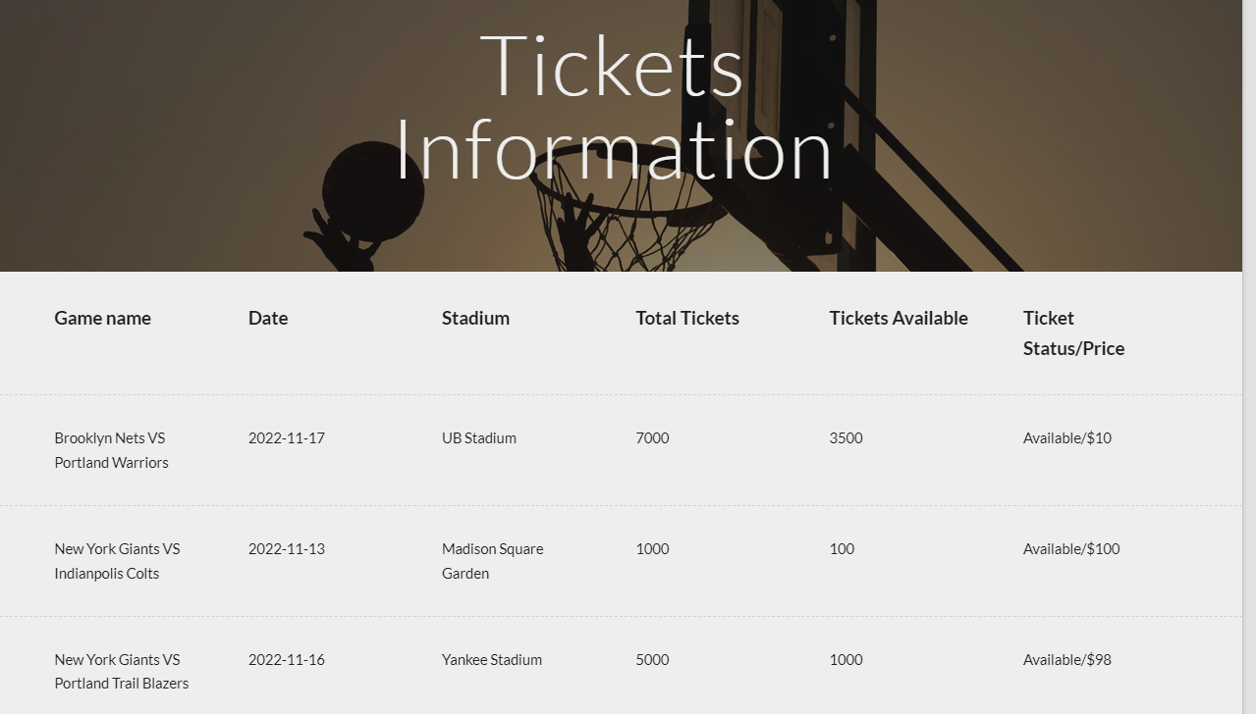

Slide 20
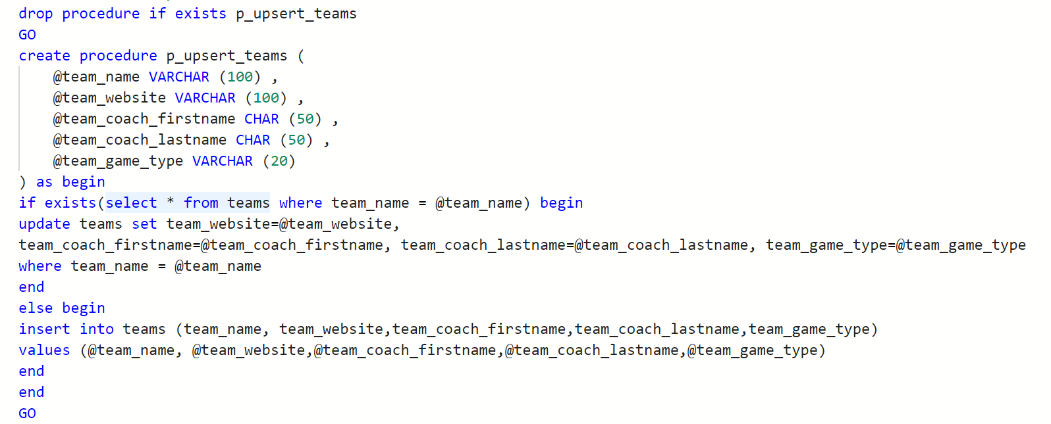
Procedure
Procedure to update or insert new teams into teams table

Slide 21
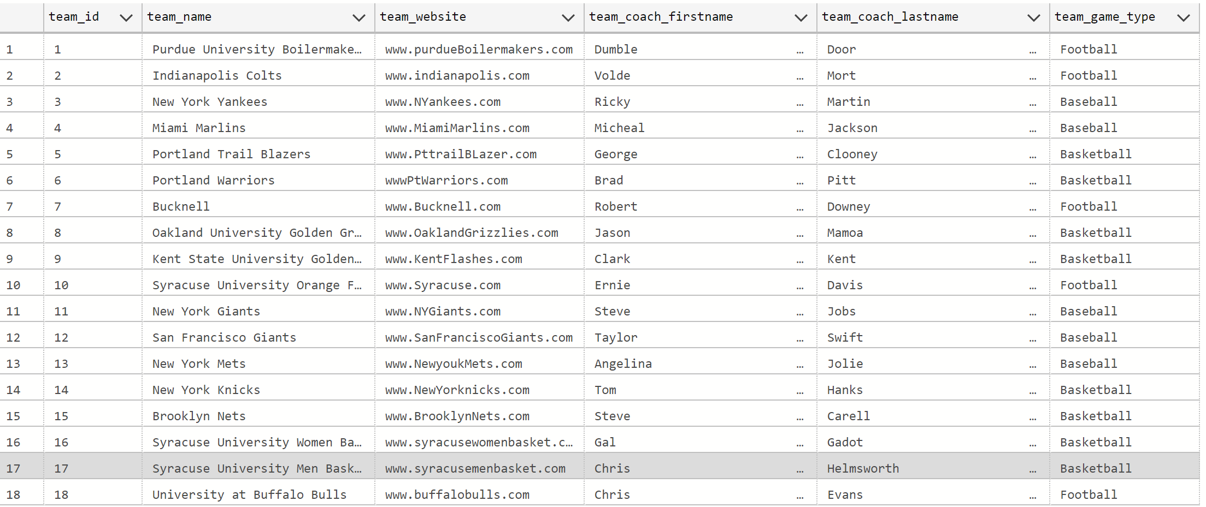
Initial teams table

Slide 22
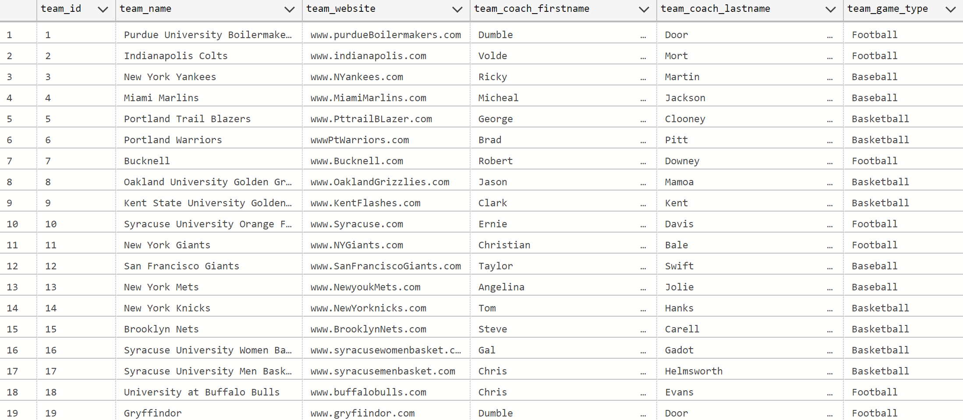
After update

Slide 23
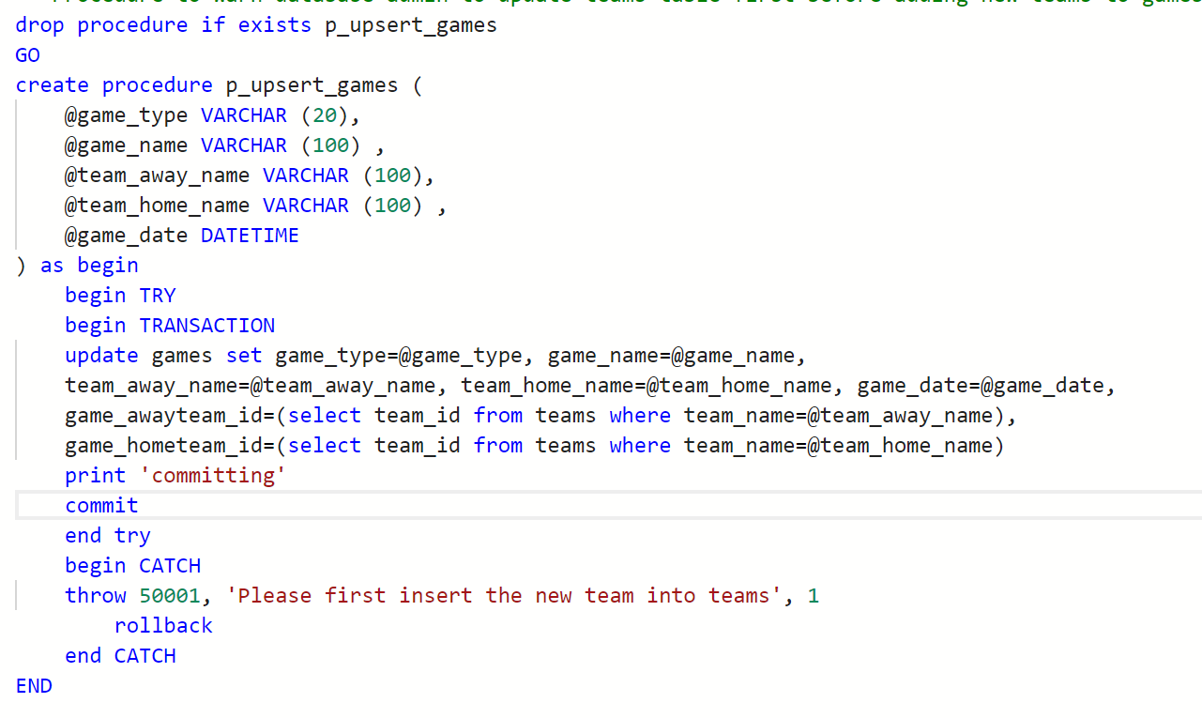
Procedure to warn database admin to update teams table first before adding new teams to games table

Slide 24
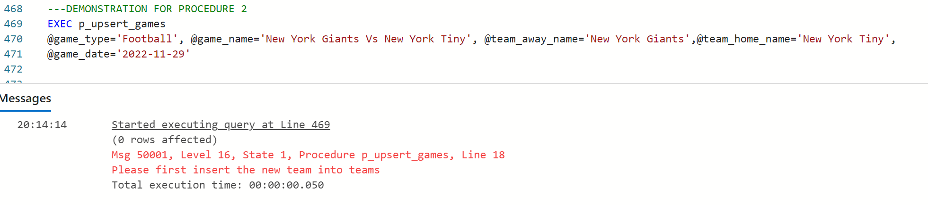

Slide 25
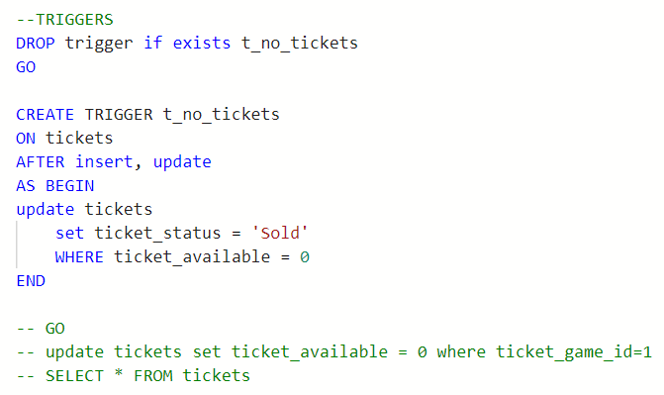
Triggers
Trigger to update ticket availability status

Slide 26
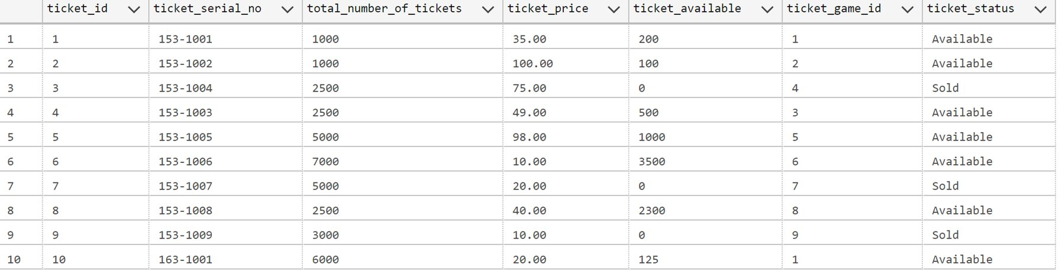

Slide 27
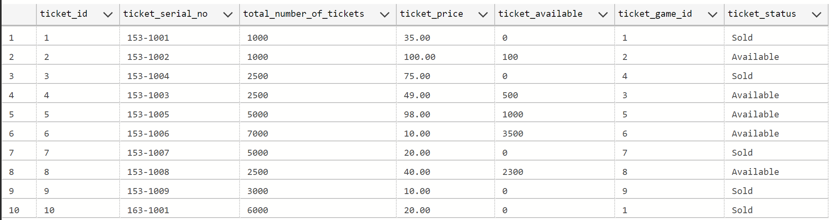

Slide 28
Thank you

